Slide 1
INTRODUCTION

Slide 2
Panel 1 – reaped benefits and peculiarities for individuals
Passive income

Slide 3
Wealth Tax

Slide 4
Wealth Tax
Yearly Tax on Securities Accounts. Current Treaty attributes power of taxation to state of Residence (art. 22,§4 DTC – “slechts in die staat belastbaar” ( “only taxable in that state”). See table of treaties. https://eservices.minfin.fgov.be/myminfin-web/pages/public/fisconet/document/460668c5-516b-4753-983c-c360ae72fe7c
Wealth tax on foreign real estate for NPO’s and private foundations as of 1 January 2024? Art. 22, § 1 Current DTC – no exclusive power of taxation (art. 22, § 1 DTC- “mag (…) worden belast”. “may (…) be taxed”)

Slide 5
Wealth Tax
Yearly tax on Collective Investment Institutions: covered tax under article 2, § 3: “met name” or “in particular” – application of art.22, § 4 DTC)- (Cass.21 April 2022)
Other wealth taxes?

Slide 6
Wealth Tax
Protocol I, 1.5:
“Indien beide verdragsluitende staten een vermogensbelasting invoeren, zullen België en Nederland onderhandelingen opstarten met het oog op de opnamen van een vermogensartikel in het Verdrag.”
“If both contracting states introduce a wealth tax, Belgium and the Netherlands will initiate negotiations with a view to including a wealth tax article in the Treaty.”

Slide 7
Cayman Tax and Belgian Dutch DTC
Dutch Administrative Office Foundation (STAK) – tax exempt (in the absence of any economic activity) = cayman tax (no proof of sufficient taxation under 1% taxation threshold is possibility);
Rental Income of Dutch Real estate – included in Box 3 (deemed income) - tax exempt under art.6 DTC, reservation of progression method as of 1 January 2024 (before that date: exempt, no reservation of progression method –eg ruling 2017.424, and 2018.1168)
Quid distribution of rental income?
In principle, taxation under article 18, 3° BITC;
No exemption under art.21, 12° BITC: for this exemption to apply, the law specifically refers to effective taxation under Belgian law. Is exemption with reservation of progression sufficient?
Article 18, 3° BITC set aside by art. 23,1 a) current DTC ? Requirement of effective taxation under new DTC is met?

Slide 8
Cayman Tax and Belgian Dutch DTC
Quid capital gain upon sale of real estate by Dutch Administrative Office Foundation?
Capital gain on foreign real estate not taxable in Belgium under BITC;
Capital gain not taxed in Box 3 in the Netherlands, but the value of the Dutch real estate is included to calculate deemed income in Box 3;
Quid distribution sales proceeds to holder of depositary receipts?
Taxable distribution under article 18, 3° BITC;
Exemption under article 21,12° BITC does not apply (no effective taxation occurred – no DTC exemption under cayman tax);
New DTC: requirement of effective taxation not met?

Slide 9
Dividends, interest and capital gains

Slide 10
High-level changes – dividends
Dividends (article 10)
5% rate in parent-subsidiary situations will be 0%, subject to a 365-day holding period
Economic double taxation of dividends Dutch BV to Belgian tax resident private individuals remains unresolved
MAP opportunity under addition to article 24(3)?
New emigration clause: under conditions exception to extra-territorial taxation of dividends
Liquidation proceeds and share repurchases now qualify as dividend income, except in emigration situations where the capital gains emigration clause is applicable (unclear how to apply this exception)
Unclear: treaty application to deemed dividends Dutch personal income tax for substantial interest (box 2, i.e. Wet excessief lenen)?

Slide 11
High-level changes – interest and capital gains
Interest (article 11)
10% rate for source country will be 0% in all situations where ultimate beneficial owner is located in other country, under conditions except for emigrated private individuals
Changed wording emigration clause for private individuals: material impact ?
Capital gains (article 13)
New emigration clause for private individuals replaces old emigration clause: broader scope

Slide 12
Emigration clauses

Slide 13



Dividends – article 10(9)
Example
New emigration clause for private individuals
Additional taxation rights for source/emigration country after emigration of shareholder and company to the other country, under the following conditions:
Company remains deemed resident of emigration country
Limited to 10-year period after emigration of shareholder
Limited insofar conditional (box 2) assessment remains outstanding
Limited to maximum tax rate of 50% of the general immigration country tax rate
Current treaty: no tax in source country in emigration situations where the place of effective management of the company is moved as well (prohibition of extra-territorial taxation of dividends)
Example: Dutch BV moves its place of effective management to Belgium and subsequently pays out a dividend of 100 to emigrated shareholder:
Dutch DWHT: 15 (new)
Belgian WHT: 30 (general rule, no elimination of double taxation?)
Waiver of Dutch conditional box 2 assessment: 15 (equal to Dutch DWHT)
Dividend
Dividend
BV
BV

Slide 14
Interest – article 11(7)
Example
Changed wording emigration clause for private individuals
Similar as under current treaty, but changed wording: material impact?
Remains limited to 10-year period after emigration of the private individual
Tax residency of company remains irrelevant, however broader deemed tax residency scope
Substantial interest definition replaced by reference to capital gains emigration clause (unclear how to apply, no longer ‘insofar’ conditional tax assessment remains open cf. new dividends emigration clause)
No longer limited to companies with a capital divided into shares (cf. dividends article)
No maximum tax rate for source/emigration country (cf. new dividends emigration clause)
No longer link required between conditional (box 2) tax assessment and company paying interest?
Example: shareholder emigrates to Belgium, BV (either resident in NL or Belgium) subsequently pays 100 interest to shareholder
Dutch PIT: 45.06, reduced to 15.06 (source state credit, 2024 maximum rate)
Belgian WHT: 30
No collection or waiver of Dutch conditional box 2 assessment
Receivable
Receivable
Interest
Interest
BV
BV

Slide 15
Capital gains – article 13(5)
Example
Current emigration clause has been replaced by a completely new clause:
New emigration clause has a much broader scope:
No longer limited to 10-year period after emigration of shareholder
No longer (directly) linked to outstanding conditional (box 2) tax assessment (!)
No longer limited to (deemed) Dutch tax resident companies
Taxable capital gain now limited to value at emigration / step-up required in immigration country
Example: shareholder emigrates to Belgium and moves place of effective management Dutch BV to Belgium, acquisition price of shares is 100, FMV at emigration is 200. Subsequent sale of shares in Belgium for 300:
Dutch conditional box 2 tax assessment at emigration: 33 (against maximum 2024 rates)
Dutch PIT at sale: 0 (no additional taxation rights anymore under new treaty)
Belgian PIT at sale: 0 (currently no capital gains tax, in principle but see next slide)
Tax payable on Dutch conditional box 2 assessment at sale: 33
Impact on waived pre-2015 NL conditional box 2 tax assessments
Action required before entry into effect new treaty to prevent taxation in NL
Application to future box 3 tax system in NL (similar for dividends/interest)?
BV
BV

Slide 16
Capital gains – article 13(5)
Example
Belgian internal law - capital gains on shares
No step-up upon immigration, no exit tax (except Cayman Tax entity)
No realization upon death or following a gift/ donation – impact calculation capital gain – see art. 102 BITC
For the time being:
tax free if realized within normal management of private wealth (if not, 33% + mun. surcharges); OR
16,5% (+mun surcharges) capital gains tax in case of transfer of substantial shareholding to a non-EEA entity;
BV
BV

Slide 17
Discussion
“The new and amended emigration clauses included in the new tax treaty are overly complicated and seem unnecessary given current Dutch national tax law on the collection of conditional box 2 personal income tax assessments.”

Slide 18
Thank you

Slide 19
IFA seminar New Dutch Belgian Tax treaty Cross border workers ‘ Working from home’
Martijn Verwijs
Senior manager employment tax at ASML
September 6, 2024
Antwerp

Slide 20
Agenda
Introduction
Relevant tax paragraphs
Art. 14 - Income from employment (Employees)
Art. 15 - Directors’ fees (member of the board)
Art. 23 - Compensation rule for Dutch cross border workers
Social security
EU Regulation
EU Framework agreement for teleworkers per July 1, 2023
Case study

Slide 21
Belgian – Dutch tax treaty 2023
Cross border workers – working from home
Art. 14 - Income from employment (Employees)
Main rule: the employee pays taxes in the country where he/she is working
Exception (taxed in the home country)
Not more than 183 days in the work country in a 12 months period; and
Salary is not being paid by an (economic) employer in the work country; and
Not a permanent establishment in work country
Points of attention
Working from home is not covered in this new tax treaty. Working from home days still being taxed in home country
Discrepancy in taxable moments and/or valuation of taxable benefits (i.e. company stock options, company cars, etc.)
Art. 15 - Directors’ fees (member of the board)
Remuneration is subject to tax in country of residence of the entity
Art. 23 - Compensation rule for Dutch cross border workers

Slide 22
EU social security regulations as of July 1, 2023
Cross border workers – EU social security regulations
Main rule
Working in the Netherlands leads to social security coverage in the Netherlands
Unless ≥ 25% is worked in Belgium (country of residence), then switch of coverage to Belgium (country of residence)
Framework agreement 1 July 2023 (exception on Main rule)
Working < 50% in Belgium (country of residence) does not lead to change of social security coverage to Belgium (country of residence)
The activities need to be qualified as telework
Stringent conditions need to be met to work ≥ 25% but < 50% from home
An A1 statement is needed
Main principle company NL: employee company NL should be covered by Dutch social security system
Risks: In case the social security position of the cross border worker switch from the Netherlands to Belgium this will lead to withholding obligations for company NL in Belgium (additional administrative burden for running a monthly payroll) besides the additional financial impact for both company NL and the cross border worker (Belgium does not have an upper limit compared with NL). The premiums in Belgium are higher/more expensive (no upper limit).
Monitoring of the working days is needed

Slide 23
Case study
Cross border worker: living in Belgium / working for a NL company
Facts
Employee works 2 days a week at home; 3 days at the office
What are the company’s obligations from a tax and social security perspective?
NL company does not have wage tax withholding obligations (payroll obligations) in the cross border worker home country (Belgium), unless the activities of the cross border worker(s) in the home country constitute a permanent establishment for NL company. The NL company might facilitate the Dutch working days directly in the Dutch payroll (additional admin burden)
NL company needs to monitor the employee’s working days for social security purposes
What are the employee’s personal income tax consequences
The cross border worker’s salary is subject to tax in the Netherlands for the part of the employment activities actually performed in the Netherlands. In case the NL company withholds 100%, the employee needs to file a Dutch personal income tax return to claim a tax refund.
The part of the cross border salary that relates to days worked from home and/or outside the Netherlands is subject to tax in the home country. The employee needs to file a Belgian annual personal income tax return to pay these taxes
New tax treaty negotiations with Belgium should cover the working from home situations and bring this more in line with the social security regulations. However, up to now no new developments.

Slide 24
Case study Statement
The new Dutch-Belgian tax treaty does not contain a working from home rule.
The employer and employees are confronted with increased (tax and social security) regulatory and administrative burden if the employer allows his cross border employees to work from home
Therefore:
A cross border worker should also be allowed to work from home without shifting the right of taxation to the state of residence (where possible)
Agree or disagree?
For what percentage?

Slide 25
The pension article
Tax treaty policy perspectives from the Netherlands & Belgium

Slide 26
The pension article in a nutshell
Article 16 DTA NL-BE 2023 = Article 18 DTA NL-BE 2001
Starting point: taxation in the state of residence.
However, taxation in the source state if:
fiscally facilitated income provisions and/or social security benefits from one of the Contracting States exceeding € 25,000 per year...
...are insufficiently taxed in the other Contracting State:
not at the generally applicable tax rate for income derived from non-self-employed professions (employees), or
the gross amount of this income is taxed at that rate for less than 90 percent

Slide 27
Relevant policy perspectives
The Netherlands:
Large 2nd pillar (taxation: EET-system)
Tax treaty policy: source taxation (Notitie Fiscaal Vedragsbeleid 2011 & 2020)
Belgian jurisprudence: uncertainty regarding Belgian taxation?
Belgium:
BE residents that work in NL > NL residents that work in BE (more NL pension paid out in BE than BE pension paid out in NL)
Change in pension article: budgetary impact
Legislation 2022: no doubts regarding Belgian taxation
Constitutional Court judgment

Slide 28
Providing clarity
Joint explanatory statement (“Gezamenlijke toelichting”)
Art. 31(3) Vienna Convention on the Law of Treaties
Explanation, including examples

Slide 29
Thank you

Slide 30
Panel 2 - Understanding challenges and prospects for business with emphasis on PE presence
Article 5 of the new bilateral tax treaty

Slide 31
Article 5: Permanent establishment (“PE”)
Fixed place of business PE
Art. 5 §1
Requirements: fixed place of business that is at the disposal of the foreign company and through which its business is wholly or partly carried on
No changes compared to the 2001 treaty
Positive list
Art. 5 §2
Examples: a place of management, a branch, an office, a factory, a workshop, a mine, an oil or gas well, a quarry or any other place of extraction of natural resources
No changes compared to the 2001 treaty
Construction PE
Art. 5 §3
Rule: a building site or construction or installation project constitutes a PE only if it lasts more than 12 months
No changes compared to the 2001 treaty

Slide 32
Article 5: Permanent establishment (“PE”)
Preparatory or auxiliary activities
Art. 5 §7
All the activities listed in the subparagraphs of article 5 §7 will be exempt from PE status only if they meet the “preparatory or auxiliary” test.
New treaty incorporates the MLI primary rule, whereas Belgium opted not to apply it under the MLI
Anti-fragmentation rule
Art. 5 §8
Permits an aggregated PE assessment where activities in a country are “fragmented” between group companies to meet the exceptions for activities that are preparatory or auxiliary.
Anti-fragmentation rule is already in effect under the 2001 treaty as a result of the application of the MLI
New agency PE definition
Art. 5 §9
Covers persons who habitually conclude binding contracts on behalf of a foreign enterprise or habitually play the principal role leading to the conclusion of contracts that are routinely concluded without material modification by the enterprise.
New treaty incorporates the MLI agency PE definition, whereas it was not applicable under the 2001 treaty as both Belgium and Netherlands made a reservation.

Slide 33
Article 5: Permanent establishment (“PE”)
Independent agent definition
Art. 5 §10
Exemption for independent agents provided they are working in the ordinary course of that business. However, not possible if the agent is (almost) exclusively working for one or more closely related enterprise(s).
New treaty incorporates the MLI independent agent definition, whereas it was not applicable under the 2001 treaty as both Belgium and Netherlands made a reservation.
Offshore activities
Art. 5 §4-6
Cover in principle all activities which are carried on offshore (no reference anymore to the exploration or exploitation of the seabed and subsoil and their natural resources). The new treaty specifies that offshore activities do not include preparatory or auxiliary activities, towing or anchoring by ships and the carriage of supplies or personnel by ships or aircraft in international traffic.
The provision with respect to offshore activities (i.e. article 24 of the 2001 treaty) has now been included in paras. 4 to 6 of article 5 of the new treaty and has been broadened in scope.

Slide 34
Article 5: Permanent establishment (“PE”)
Anti-abuse rule
Art. 5 §6
Activities carried out by an enterprise of a contracting state in the other contracting state at a building site or construction or installation project for periods exceeding 30 days without exceeding 12 months are combined with connected activities carried on at the same building site or construction or installation project during different periods of time exceeding 30 days by one or more closely related enterprises. The same rule applies to offshore activities, albeit without any lower limit time duration requirement
New treaty incorporates the MLI anti-abuse rule (“Splitting-up of Contracts”), whereas it was not applicable under the 2001 treaty as Belgium made a reservation for the entirety of this MLI article not to apply (whilst Netherlands only relating to the exploitation of natural resources).

Slide 35



PE and cross-border teleworking
Context
Company A
Many companies, especially after the coronavirus pandemic, have implemented a homeworking policy allowing their employees to work remotely for one or more days a week. Often this policy is also applicable vis-à-vis employees living abroad, i.e. they obtain permission, although their employer is located in the Netherlands ("work state"), to carry out part of their activities from their home in Belgium ("residence state"), or vice versa.
The main question that arises is whether teleworking can create a home office PE for the employer in the employee's residence state.
Work state
Residence state
Residence state
Work state
Sara
Company B
Koen
264km commuting distance
At least 3 days home working
55km commuting distance
1 day home working

Slide 36
Some critical observations (1)
No formal rules for home office PE in the new treaty, no formal extension of the BE-NL agreement of 23 November 2023
Only home office PE if structurally and mandatory working from home (less than 50% at home is assumption of ‘not at the disposal’)
Granting of ICT equipment etc is insufficient for PE qualification
Only applicable to employees working from home, not directors?
Why only for fixed place of business PE, not for agency PE?

Slide 37
Some critical observations (2)
Little comparable agreements. What to do in relation to, for instance, Germany and Luxembourg from a Belgian or Dutch perspective?
Anti-fragmentation for several home office-PEs in the same country?
What about profit allocation to all those small home office PEs?
Impact on the relation with Article 14(2) BE-NL treaty?
Arbitrary borderlines in 50%-rule?

Slide 38
Some critical observations (3)
Need for a general position
Belgian Tax Authorities would consider the Belgian-Dutch Agreement as generally applicable
The Netherlands has not yet communicated regarding this matter.
Other countries are also concluding bilateral agreements (Switzerland-France, Switzerland-Italy), with different arragements, scope & thresholds
=> Double (non-)taxation risk

Slide 39
Some critical observations (4)
Way forward?
Remote working / global mobility is high on the agenda of OECD & EU:
Should the situation as is be maintained, or
Should OECD guidelines be changed?
Situation as is remains, but only if a certain threshold is not exceeded?
Taxation in the State where the employer is established?
Taxation in the resident state of the employee?
We do not need a universe of (administratively burdensome) micro-PEs
Why should a mobile workforce be subject to different tax and social security allocation rules?

Slide 40
Some critical observations (5)
Quid alignment with domestic (tax) law?
No PE does not mean no Belgian establishment;
Quid reporting obligations & automatic exchange of information?
Need for further alignment with international social security?
Different scope & threshold
Applicable labour law?

Slide 41
Thank you

Slide 42
Permanent establishment and teleworking
The Belgian-Dutch Agreement of 23 November 2023

Slide 43
Belgian-Dutch agreement
The agreement is based on the OECD Commentary :
Importance of the « disposal » test
Activities of a preparatory or auxiliary character do not create a PE
All facts and circumstances are taken into account
Main features:
50 % threshold
3 types of teleworking
Occasional teleworking (no PE creation)
Structural teleworking with the possibility of working on site (no PE creation)
Structural and compulsory teleworking : constitutes a PE (use of the home office on a continuous basis + the employee is required to work from home)

Slide 44
Belgian-Dutch agreement
The category « structural and compulsory teleworking » includes also de facto compulsory teleworking, such as when :
no workplace is made available to the employee by the enterprise
the worker cannot carry out his work adequately or in accordance with the employement contract if he doesn’t work from home
Examples of activities which could (depending of circumstances) be considered as having an auxiliary character

Slide 45
Thank you

Slide 46
Panel 3 - Delving into the classics: how recent Belgian and Dutch case law keeps the narrative on tax treaty and EU abuse and beneficial ownership relevant

Slide 47
Panel members
Chair: Margriet Lukkien – Tax Partner at Loyens & Loeff
Speakers:
Linda Brosens – Tax lawyer at Loyens & Loeff/Professor at the University of Antwerp
Loes van Hulten – Lecturer Fiscal economy at Erasmus University Rotterdam/Senior Manager at Deloitte
Ward Willems – Belgian Federal Tax Administration, Large Enterprises Section (International Tax Unit)

Slide 48
Agenda
Withholding tax relief under pressure
Relevant changes in Belgium-Netherlands DTT
Abuse of Belgium-Netherlands DTT
Abuse of EU Directives and interaction DTT
Beneficial ownership
Concluding remarks

Slide 49
Withholding tax relief under pressure
Under pressure in source countries
Many tax developments
Pressure points: abuse and beneficial ownership
Impact by OECD MLI PPT, EU GAAR, EU case law
Attention points:
Flow-through
Free disposition of income
Substance
Remuneration for the financing entity
Parent
HoldCo/FinCo
Interest/
dividend
Subsidiary

Slide 50
Relevant changes in Belgium-Netherlands DTT
Preamble DTT 2001
Preamble DTT 2023
“The Government of the Kingdom of Belgium and the Government of the Kingdom of the Netherlands,
Desiring to conclude a Convention for the avoidance of double taxation and the prevention of fiscal evasion with respect to taxes on income and on capital, (..).”
“The Government of the Kingdom of Belgium and the Government of the Kingdom of the Netherlands,
Desiring to further develop their economic relationship and to enhance their cooperation in tax matters,
Intending to conclude a Convention for the elimination of double taxation with respect to taxes on income without creating opportunities for non-taxation or reduced taxation through tax evasion or avoidance (including through treaty-shopping arrangements aimed at obtaining reliefs provided in this Convention for the indirect benefit of residents of third States), (..).”

Slide 51
Relevant changes in Belgium-Netherlands DTT
PPT DTT 2001 prior to application MLI
PPT DTT 2001 (via MLI) and DTT 2023
No PPT
“1. Notwithstanding the other provisions of this Convention, a benefit under this Convention shall not be granted in respect of an item of income if it is reasonable to conclude, having regard to all relevant facts and circumstances, that obtaining that benefit was one of the principal purposes of any arrangement or transaction that resulted directly or indirectly in that benefit, unless it is established that granting that benefit in these circumstances would be in accordance with the object and purpose of the relevant provisions of this Convention.
2. Where a benefit under this Convention is denied to a person under paragraph 1, the competent authority of the Contracting State that would otherwise have granted this benefit shall nevertheless treat that person as being entitled to this benefit, or to different benefits with respect to a specific item of income, if such competent authority, upon request from that person and after consideration of the relevant facts and circumstances, determines that such benefits would have been granted in the absence of the transaction or arrangement referred to in paragraph 1. The competent authority of the Contracting State to which a request has been made under this paragraph by a resident of the other Contracting State shall consult with the competent authority of that other Contracting State before rejecting the request.”

Slide 52
Relevant changes in Belgium-Netherlands DTT
Par. 12 and 16 Protocol DTT 2001
Par. 2 and 4 Protocol DTT 2023
“The provisions of paragraph 2 of Article 10, shall not apply to dividends which a company which is a resident of one of the Contracting States pays to a company which is a resident of the other Contracting State, on which, pursuant to the provisions of the Directive on the common system of taxation applicable to parent companies and subsidiary companies of different Member States (90/435/EEC), as it may be amended, no tax may be levied by the State in which the company paying the dividend is a resident.”
“If an EEC directive regarding a common tax system for payments of interest and royalties between enterprises, as it may eventually be amended, enters into force, the provisions of this directive, insofar as they depart from the provisions of paragraphs 2 and 3 of Article 11, shall apply insofar as interest is concerned.”
“No provision of this Convention shall be construed as preventing a Contracting State from applying the provisions of its domestic laws for the prevention of tax avoidance and evasion.”
“Nothing in this Convention shall prevent the application of Council Directive (EU) 2022/2523 of 14 December 2022 ensuring a global minimum level of taxation for multinational enterprise groups and large-scale domestic groups in the Union.”

Slide 53

Abuse of BE-NL DTT
Can national GAARs be applied to combat alleged treaty abuse?
What is the relationship between PPT and SAARS in DTTs?
How to apply the PPT?
What are the consequences if treaty abuse is established?

Slide 54




Court First Instance Brussels 21 April 2023
Simplified structure chart until 2011
Facts (simplified)
BelCo 1 has 2 loans with SwissCo
Loan financing the acquisition of BelCo’s (including BelCo 2 and 3)
Loan to finance a loan to BelCo 2 (used to incorporate FinCo)
BelCo 3 takes loan with SwissCo to finance incorporation of FinCo
Finco provided debt financing to other group companies
SwissCo is largely financed by long-term interest-free loans from LuxCo 2
SwissCo has a Swiss tax ruling allowing a notional interest deduction on its debt (leading to an ETR of 1,87% on the interest income it receives)
NedCo
LuxCo 1
interest
BelCo 1
interest
LuxCo 2
BelCo 2
BelCo 3
SwissCo
Notional interest deduction
Notional interest deduction
FinCo
interest
interest
Group Companies

Slide 55
Court First Instance Brussels 21 April 2023
Restructuring steps
Simplified structure chart 2011-2014
Restructuring steps
Simplified structure chart 2014-2016
NedCo
NedCo
Incorporation of LuxCo 3 by BelCo 2 and 3
Contribution of FinCo to LuxCo 3
Capital reduction by Finco giving rise to debt with LuxCo 3 (hyrid loan (PPL))
transfer of loan BelCo 1-2 to SwissCo
Finances capital reduction by BelCo 1 (and ultimately repayment of external debt NedCo)
Incorporation LuxCo 4 which subscribes to capital increase of LuxCo 2
LuxCo 2 uses the funds to grant new interest-free loans to SwissCo
LuxCo 1
LuxCo 1
BelCo 1
interest
LuxCo 2
interest
BelCo 1
interest
LuxCo 2
BelCo 2
BelCo 3
BelCo 2
BelCo 3
SwissCo
SwissCo
LuxCo 3
LuxCo 3
interest
interest
interest
FinCo
FinCo
LuxCo 4
interest
Group Companies

Slide 56
Court First Instance Brussels 21 April 2023
Simplified structure chart 2014-2016
Decisions Court of First Instance
Court concludes to the existence of tax abuse
Funds borrowed from SwissCo were in fact rerouted back to SwissCo (“round tripping”)
Leading to interest payments by BelCo’s to SwissCo, who is barely taxed on that income
LuxCo 2 and 3 lack economic substance
BelCo 2 and 3: loans longer serve any purpose (FinCo was de facto unwinded in 2014), yet loans were not repaid – Finco was eventually liquidated mid 2016)
Use of domestic GAAR does not constitute treaty override since “a GAAR is considered to be consistent with the general principles that a treaty cannot be applied in abusive situations” (free translation)
NedCo
LuxCo 1
BelCo 1
interest
LuxCo 2
BelCo 2
BelCo 3
SwissCo
LuxCo 3
interest
FinCo
LuxCo 4

Slide 57

Dutch Supreme Court July 2006
Facts (simplified)
X BV is a Dutch holding company owned by Dutch resident Y.
In Oct. 1996 X BV and Dutch resident Y ‘move’ to Belgium.
In Dec. 1996 Y sells the shares in X BV.
Y
Y
X BV
X BV
Dec. 1996 Sale of shares
< Oct. 1996
> Oct. 1996

Slide 58
Dutch Supreme Court July 2006
Decision Supreme Court
The Dutch Supreme Court rules that the capital gains from the sale of the shares are not allocated to the Netherlands.
The purpose of the transaction was not relevant according to the Dutch Supreme Court.
→ PPT impact?
Y
Y
X BV
X BV
Dec. 1996 Sale of shares
< Oct. 1996
> Oct. 1996

Slide 59
Abuse of EU Directive and interaction DTT
Are historical facts relevant to determine abuse?
Do the Netherlands and Belgium apply the EU Directive abuse test in line with CJEU case law?
What are the consequences of abuse of EU Directive?
Can BE-NL DTT still be applied?

Slide 60



Ghent 1 December 2020/ Supreme Court 30 November 2023
Simplified structure chart 2006-2007
Restructuring steps
Simplified structure chart 2012-2013
LLCs/AGs
Step 1: Holdco BE merges into X and X merges into Y (capital of Y BE increases with approx. 20mio).
Step 2: SAS & CV incorporate Holdco Lux.
Step 3: Holdco Lux incorporates B CZ.
Step 4: CV is converted from closed to open CV.
Step 5: Y BE sells shares Opco CZ to B CZ for 95 mio€, 59m€ paid via bank loan, remainder remains outstanding (receivable).
Step 6: Holdco Lux purchases Y BE for 81 mio€ which can be repayed for 20mio with cash contribution received from SAS.
Step 7: Y BE distributes dividend to Holdco Lux of 75m€
Step 8: Holdco Lux repays outstanding debt to CV for 61mio.
Step 9: Y BE reduces capital for 20mio (in kind - upstream receivable)
Step 10: CV distributes approx. 69 mio to SH
Step 11: B CZ and Opco CZ merge.
Step 12: Holdco Lux contributes receivable to B CZ.
LLCs/AGs
STAK
STAK
CV
CV
SAS
HoldCo Lux
X
Y
Holco
OpCo
Y
OpCo
Dividend
Opco
Opco

Slide 61
Ghent 1 December 2020/ Supreme Court 30 November 2023
Decision Courts:
Court of Appeal concludes to existence of tax abuse
Indications of abuse (a.o.):
Via disputed techniques income is up streamed tax-free soon after the receipt thereof to ultimate SHs
HoldCo interposed with no substance while group has no presence in Lux
Similar technique used in 2006
Condition Dutch ruling circumvented; statement representative
No sufficient counterproof:
The entry of the third-party investor explains existence of JV, but does not provide justification for setting it up in Lux nor for all other steps
Taxpayer provides merely general justifications
Supreme Court confirms decision of Court of Appeal
LLCs/AGs
STAK
CV
SAS
HoldCo Lux
Y
OpCo
Dividend
Opco

Slide 62

The Hague Court of Appeal October 2022
2007-2011
2011-2016
Facts (simplified)
X BV is a Dutch holding company owned by Dutch resident Y.
In 2011 X BV and Dutch resident Y ‘move’ to Curaçao.
1 January 2016: replacement of the BRK by the BRNC.
In 2016 X BV receives a dividend from Opco BV.
Y
Y
X BV
X BV
Dividend
Opco BV
Opco BV

Slide 63
The Hague Court of Appeal October 2022
2007-2011
2011-2016
Decision Court
The Hague Court of Appeal holds that the anti-abuse provision for substantial shareholdings in the Dutch Corporate Income Tax Act 1969 is not applicable.
Relevant elements (a.o.)
Migration to Curaçao not for tax reasons
BRK to BRNC in essence leads to the advantage
Opinion of Advocate General is in accordance with judgment of the The Hague Court of Appeal.
To be assessed by the Dutch Supreme Court.
Y
Y
X BV
X BV
Dividend
Opco BV
Opco BV

Slide 64
The Hague Court November 2023
Simplified structure chart 2000-2013
Simplified structure chart >2013
Facts (simplified)
X Ltd receives dividends from Z BV.
The underlying funds from which the dividends were paid originate from activities that took place before Z BV (or any other Dutch entity) was established.
Y1
Y1
Y1
Y1
Y1
Y2
Y1
Y2
X Ltd
X Ltd
Dividend
Various Opco’s
Z BV
Various Opco’s

Slide 65
The Hague Court November 2023
Simplified structure chart 2000-2013
Simplified structure chart >2013
Decision Court
The Hague Court holds that the anti-abuse provision for substantial shareholdings in the Dutch Corporate Income Tax Act 1969 is not applicable.
Relevant elements (a.o.)
Reasons for the restructuring
Bilateral investment treaty
As the fund originated abroad, there is no Dutch claim
To be assessed by the Court of Appeal.
Y1
Y1
Y1
Y1
Y1
Y2
Y1
Y2
X Ltd
X Ltd
Various Opco’s
Z BV
Dividend
Various Opco’s

Slide 66
Amsterdam Court of Appeal June 2022 (i)
Family
Facts
X BV is a holding company that receives dividends from A BV
X BV
Has no substance;
Has two other assets, i.e. two classical cars; and
Is not involved in the active management of A BV and / or Fund BV and does not perform any other activities.
X BV
Dividend
~39%
A BV
Fund BV

Slide 67
Amsterdam Court of Appeal June 2022 (i) cont’d
Decision Court
Amsterdam Court of Appeal holds that the dividend withholding tax exemption is not applicable due to application of the anti-abuse provision in the Dividend Withholding Tax Act 1965.
Relevant indicators
No relevant substance at X BV level;
No actual business at X BV level;
No involvement in the active management of A BV and or Fund BV;
X BV does not perform any further activities; and
Family determines the decision-making of X BV and therefore the profit appropriation.
Judgment of lower court and opinion of the Advocate General are in accordance with judgment of the Amsterdam Court of Appeal.
To be assessed by the Dutch Supreme Court.
Family
X BV
Dividend
~39%
A BV
Fund BV

Slide 68
Amsterdam Court of Appeal June 2022 (ii)
Family
Facts
A NV is a holding company that receives dividends from inter alia B BV
A NV
Has substance in Belgium albeit limited;
Has operational costs amounting to more than € 500,000 (related to management fee and wage);
Has other subsidiaries and is involved in the active management of some of these subsidiaries;
However, it is not involved in the active management of B BV and/or Fund BV.
Dividends are not distributed up to the family but reinvested.
X BVBA
Y BVBA
A NV
Dividend
~25%
B BV
EU subs
EU subs
Fund BV

Slide 69
Amsterdam Court of Appeal June 2022 (ii) cont’d
Decision Court
Amsterdam Court of Appeal holds that the dividend withholding tax exemption is not applicable due to application of the anti-abuse provision in the Dividend Withholding Tax Act 1965.
Relevant indicators
Actual business at the level of A NV;
No involvement of A NV in B BV and/or Fund BV;
A NV’s equity interest in B BV is not attributable to the actual business of A NV;
De facto no office space;
Administration of A NV is not being performed by its own staff; and
Family determines the decision-making of A NV and therefore the profit appropriation.
The lower court held that the anti-abuse provision was not applicable.
Opinion of Advocate General is in accordance with judgment of the Amsterdam Court of Appeal.
To be assessed by the Dutch Supreme Court.
Family
X BVBA
Y BVBA
A NV
Dividend
~25%
B BV
EU subs
EU subs
Fund BV

Slide 70
Beneficial Ownership
What is the relationship between BO and abuse and what are the experiences in Belgium and the Netherlands?
How to interpret BO under existing and new DTT and what is the relationship with the IRD?
What are relevant criteria to determine BO?
What are the consequences if direct recipient is not the BO?

Slide 71
Beneficial ownership and abuse
Intertwined with abuse
Separate condition
Principle: tax authorities must proof that abuse is present and BO is merely indication of abuse
Principle: taxpayer must proof recipient is BO, even in absence of abuse
CJEU Brisal case law?

Slide 72
Court First Instance Leuven 27 October 2023
US Inc
Facts
BV 2 is finance company of group since 2016 with 35 employees
In 2017, Belco paid interest to BV 2 in respect of 5 loans granted to Belco to finance acquisitions
BV 1 and BV 2 pay interest to LLC on outstanding loans (previously CV)
BV 1 and BV 2 form fiscal unity
A WHT exemption was claimed by Belco based on Art. 11 BE-NL DTT
The Belgian Tax Authorities refuse WHT exemption
Gibraltar
CV
LLC
Interest on 4 loans
BV 1
BelCo
Interest on 1 loan
BV 2
Interest on 5 loans

Slide 73
Court First Instance Leuven 27 October 2023
US Inc
Decision Court :
BO under DTT = BO under IRD
Protocol
Member States must comply with EU law (principle sincere cooperation)
BO = entity which benefits economically from the interest received and accordingly has the power freely to determine the use to which it is put.
BV 2 is not BO of interest income
Gibraltar
CV
LLC
Interest on 4 loans
BV 1
BelCo
Interest on 1 loan
BV 2
Interest on 5 loans

Slide 74
Court First Instance Leuven 27 October 2023
US Inc
Questions:
Can Court use criteria of abuse to interpret BO ?
What are relevant criteria to determine Beneficial Ownership?
Gibraltar
CV
LLC
Interest on 4 loans
BV 1
BelCo
Interest on 1 loan
BV 2
Interest on 5 loans

Slide 75
Consequence of not being BO?
DutchCo
Interest/
dividend
HoldCo/FinCo
OECD Commentary : Subject to other conditions imposed by the Article and the other provisions of the Convention, the limitation of tax in the State of source remains available when an intermediary, such as an agent or nominee located in a Contracting State or in a third State, is interposed between the beneficiary and the payer but the beneficial owner is a resident of the other Contracting State (the text of the Model was amended in 1995 and in 2014 to clarify this point, which has been the consistent position of all member countries).
Interest/
dividend
BelCo

Slide 76

Concluding remarks
Various withholding tax relief discussions in source countries
Still grey areas and inconsistencies between source countries
Solid documentation and good cash management are important
Historical elements can play a role

Slide 77
Thank you

Slide 78


Panel 4 - CURRENT PRACTICE OF DISPUTE RESOLUTION MECHANISMS : instruments in force and expected changes
- Rhys Bane, NL Senior Associate (Lubbers, Boer & Douma)
- Filip Haes, BE Delegated Competent Authority for Transfer Pricing MAP and APA
- Harm Mark Pit, NL MAP Team, Assisting Professor (RUG)
- Caroline Docclo (chair), BE Avocat (Loyens&Loeff), Professor (ULiège - ULB)

Slide 79
LEGAL HISTORY AND AVAILABLE INSTRUMENTS (Caroline Docclo)
EXAMPLES OF MAP-ISSUES AND SOLUTIONS
MAP-APA PRACTICAL GUIDANCE
TAX PAYERS’ RIGHTS
POLICY ISSUES

Slide 80
National and international procedures
National procedure
Taxpayer v. revenue service
Taxpayer’s protection
The final decision of a judge is binding
International procedure
Taxpayer is not a party
Competent authorities may agree to disagree (unless arbitration is provided)
Taxpayer not bound by the decision of the competent authorities
Arbitration is not an arbitration

Slide 81
Available international procedures
Convention on the elimination of double taxation in connection with the adjustment of profits of associated enterprises (90/436/EEC)
Overeenkomst van 5 juni 2001 tussen het Koninkrijk België en het Koninkrijk der Nederlanden tot het vermijden van dubbele belasting en tot het voorkomen van het ontgaan van belasting inzake belastingen naar het inkomen en naar het vermogen
The Multilateral Convention of 24 November 2016 to Implement Tax Treaty Related Measures to Prevent Base Erosion and Profit Shifting
Council Directive (EU) 2017/1852 of 10 October 2017 on tax dispute resolution mechanisms in the European Union
Verdrag van 21 juni 2023 tussen het Koninkrijk België en het Koninkrijk des Nederlanden tot het vermijden van dubbele belasting inzake belastingen naar het inkomen en tot het voorkomen van het ontduiken en ontwijken van belasting

Slide 82
LEGAL HISTORY AND AVAILABLE INSTRUMENTS
EXAMPLES OF MAP-ISSUES AND SOLUTIONS (Harm Mark Pit)
MAP-APA PRACTICAL GUIDANCE
TAX PAYERS’ RIGHTS
POLICY ISSUES

Slide 83
MAP statistics – worldwide trend

Slide 84
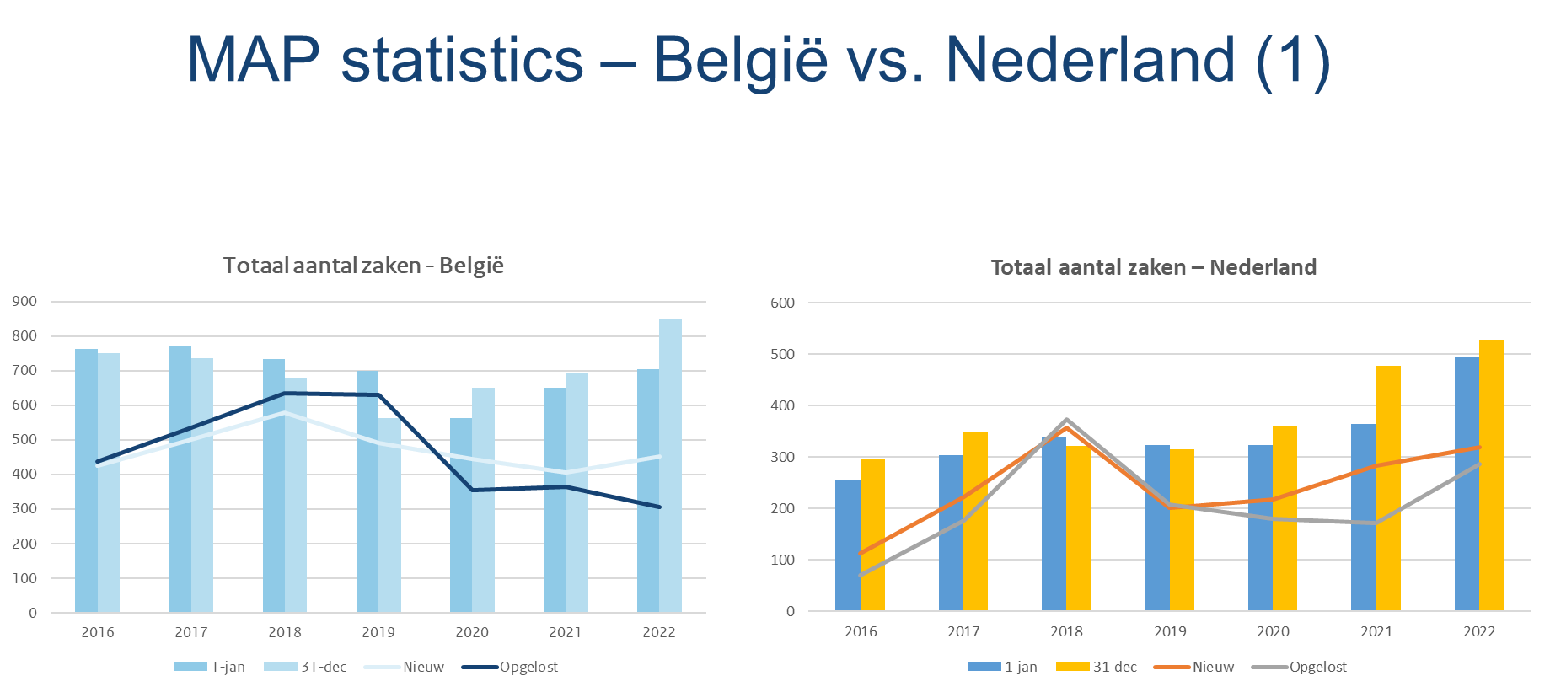

Slide 85
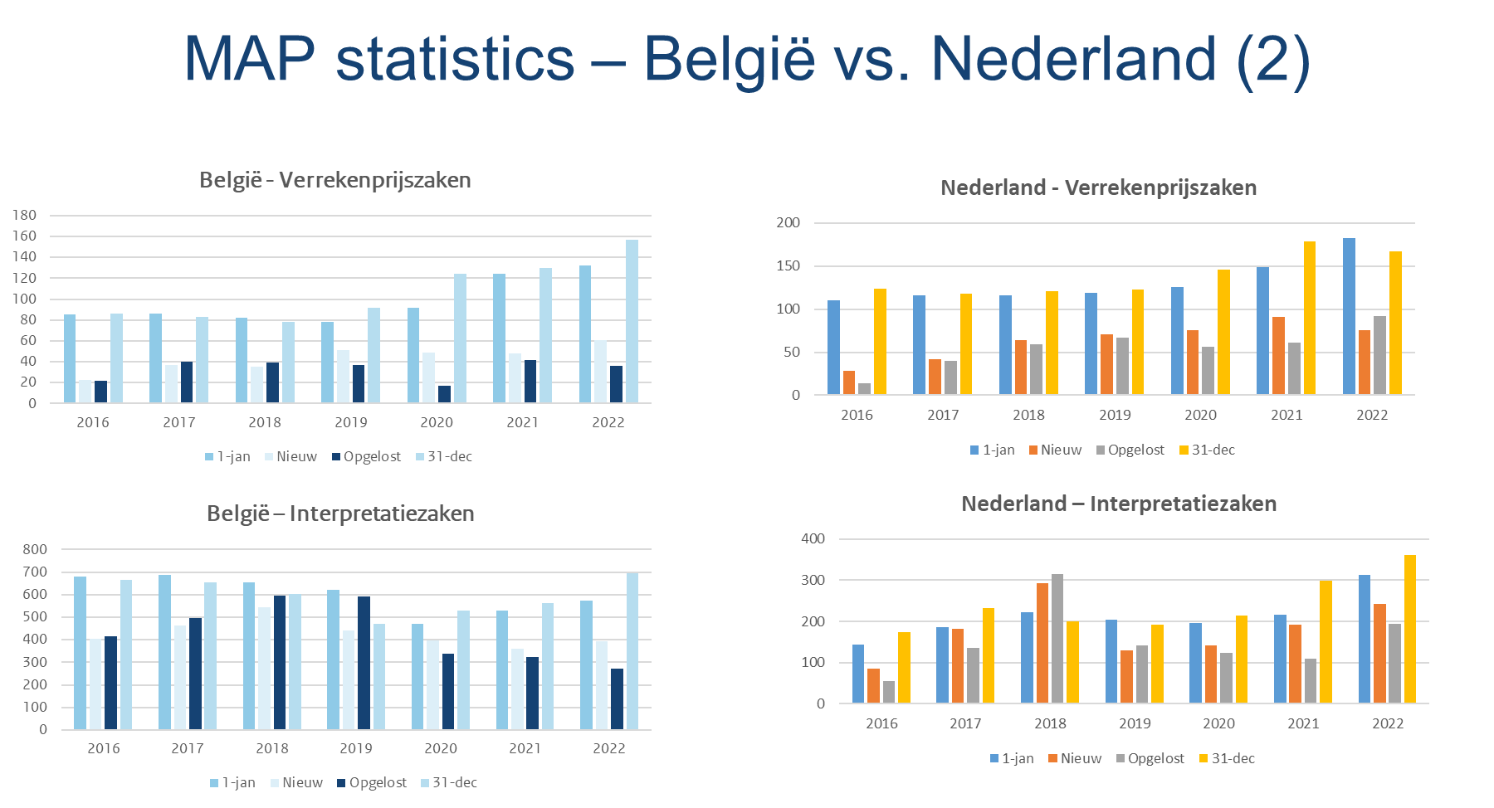

Slide 86
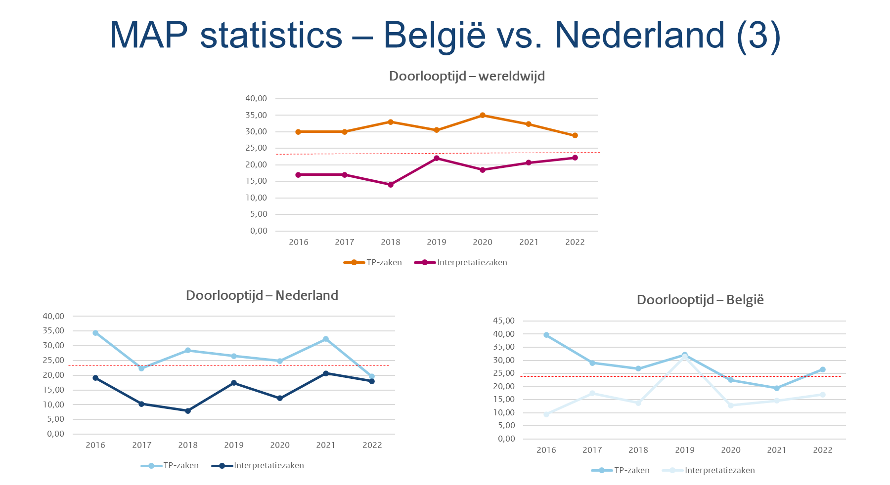

Slide 87
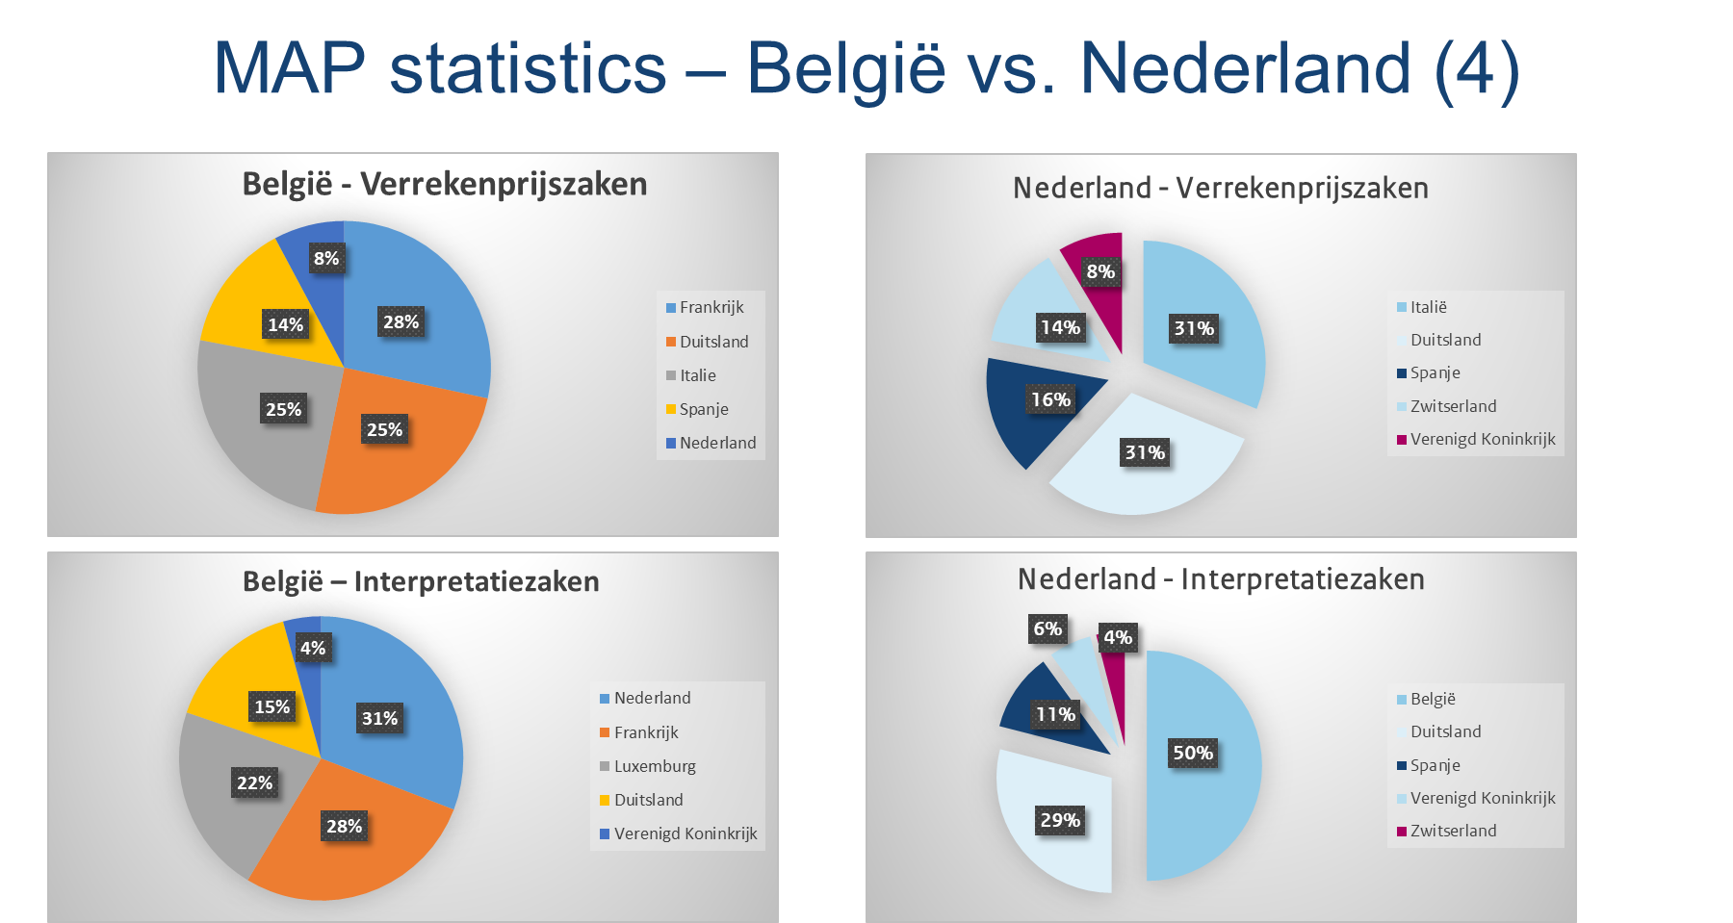

Slide 88
LEGAL HISTORY AND AVAILABLE INSTRUMENTS
EXAMPLES OF MAP-ISSUES AND SOLUTIONS
MAP-APA PRACTICAL GUIDANCE (Filip Haes)
TAX PAYERS’ RIGHTS
POLICY ISSUES

Slide 89

1. The tip of the iceberg

Slide 90

2. MAP.APA@minfin.fed.be

Slide 91

3. Admissibility

Slide 92

4. Fact finding

Slide 93

5. Position paper

Slide 94

6 . Physical meeting

Slide 95

7. Taxpayer’s agreement

Slide 96

8. Implementation

Slide 97
LEGAL HISTORY AND AVAILABLE INSTRUMENTS
EXAMPLES OF MAP-ISSUES AND SOLUTIONS
MAP-APA PRACTICAL GUIDANCE
TAX PAYERS’ RIGHTS (Rhys Bane)
POLICY ISSUES

Slide 98
(Domestic) remedies if MAP access is denied
Simple, right?
‘Closed system’ of legal remedies: No legal remedy against an administrative decision ‘pursuant to tax law’ unless tax assessment or ‘appealable decision’ (Article 26(1) State Taxes Act).
What about self-assessed taxes?
Payment is a fictitious ‘appealable decision’ (Article 26(2) State Taxes Act).
Applied to MAP requests:
Decision on MAP request ≠ tax assessment.
Decision on MAP request ≠ ‘appealable decision’ (spoiler alert: until 1/1/2023).
But… Tax treaties and the EU Arbitration Convention are not ‘tax law’.
Tax law: both this Act as well as other legal provisions on the levying of taxes that fall within the scope of Article 1 (Article 2(1)(a) STA).
The NL implementation of the EU Dispute Resolution Directive probably is ‘tax law’ (the legislator has at least assumed so).
25 July 2017: District Court of Amsterdam
16 July 2019: Tax Arbitration Act (retroactive effect to FY 2018)
3 February 2021: Council of State (Administrative Court Division)
1 January 2023: Article 39a State Taxes Act

Slide 99
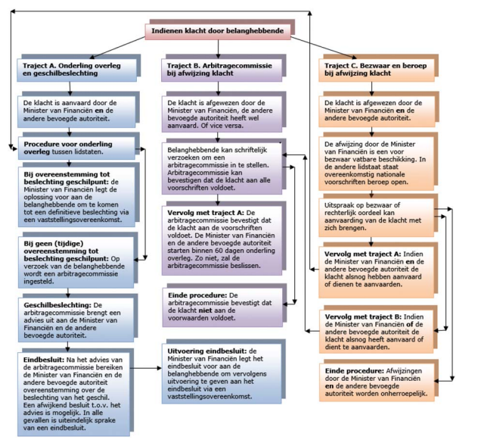
(Domestic) remedies if MAP access is denied
Tax Arbitration Act (NL implementation of the EU Dispute Resolution Directive) has its own system (flowchart: credits to the Dutch Ministry of Finance)

Slide 100
(Domestic) remedies if MAP access is denied
What about the denial of access to arbitration after an unsuccessful MAP?
EU Dispute Resolution Directive and NL Tax Arbitration Act clear: no legal remedies (what about Article 47 of the Charter of Fundamental Rights of the European Union?).
Tax treaties and EU Arbitration Convention: My view = analogous application of District Court of Amsterdam 25 July 2017 & Council of State (Administrative Court Division) 3 February 2021: Written decision (denial) of an administrative body (DTA MAP team) pertaining to a public law (tax treaty/EU Arbitration Convention) legal act + no ‘tax law’ within the meaning of the STA and therefore no closed system of legal protection.
Admitted: extremely niche issue. But: judicial check on the validity of reasons for denial (e.g., penalty or no double taxation).

Slide 101
LEGAL HISTORY AND AVAILABLE INSTRUMENTS
EXAMPLES OF MAP-ISSUES AND SOLUTIONS
MAP-APA PRACTICAL GUIDANCE
TAX PAYERS’ RIGHTS
POLICY ISSUES (Harm Marc Pit – Filip Haes)

Slide 102
Thank you

Slide 103
Panel 5 - The new Dutch classification rules and interplay with Belgian entities

Slide 104
Introduction
Ilse Lagerweij, Tax associate at DLA Piper
Bart Peeters, Professor at University of Gent, University of Antwerp, University of Liège
Gijs Fibbe – Tax partner at Baker Tilly Netherlands N.V. / Lecturer Erasmus Universiteit Rotterdam

Slide 105
Agenda
Introduction new Dutch classification rules as per 2025
Reaction from a Belgian perspective
Example Belgian CV from the Belgian Venture Capital and Private Equity Association
Conclusion

Slide 106
The new Dutch classification rules
Ilse Lagerweij, Tax associate at DLA Piper

Slide 107
Current Dutch classification rules
Comparability Analysis Companies (decree no. CPP2009/519M)
Whether the entity can hold the legal title to assets (i.e., whether it has legal personality)
Whether the liability of all the participants in the entity is limited (to their contributions or obligation to contribute).
Whether the entity has a capital divided into shares in a legal sense (or whether the capital of the entity should be considered to be divided into shares).
Whether participants can accede or be replaced without prior consent of other participants.
3 positive answers = comparability to a company
Not comparable to a company? Transparent – unless similar to a limited partnership
Decree does not apply to legal forms that are comparable to associations, foundations, mutual funds, or special purpose funds (Doelvermogens). These categories should be tested separately.
The entity conducts business under a common name;
There is at least one general partner and one limited partner;
The general partner is fully liable or is liable for equal parts;
The limited partner is internally liable only for its contribution;
The limited partner does not perform any outward management activities; and
The entity does not have a capital divided into shares.

Slide 108
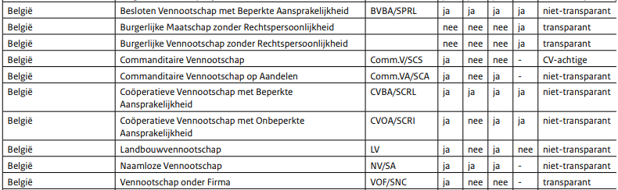
Current Dutch classification rules
List of ‘Qualified Foreign Entities’ by the Dutch Tax Authorities
The Dutch tax authorities have confirmed the list is an indication based on previous assessments of the relevant legal entity. The assessment of the tax status of the entity remains a case-by-case assessment and parties can therefore not solely rely on this list.

Slide 109
The new Dutch classification rules as per 2025
Schematic Overview Analysis
Comparability based on hallmarks?
No
Yes
Tax Residency
Yes
More than 1 comparable category
Foreign
Netherlands
No
Symmetry Method
Fixed Method
Tax Status Qualification of Comparable Dutch Entity

Slide 110
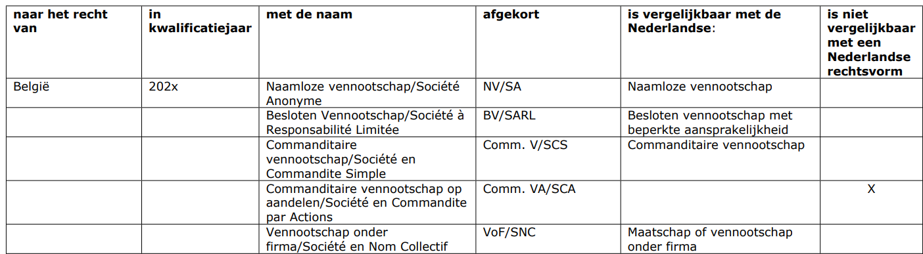
The new Dutch classification rules as per 2025
Comparability Analysis
Is the entity a ‘qualified entity’ based on the list attached to the decree?
If the entity is not listed, it should be qualified by comparing the characteristics and organisation of the entity with the hallmarks in the decree.
If the entity is comparable to a Dutch mutual fund or transparent fund, such qualification should prevail over the other categories.

Slide 111
The new Dutch classification rules as per 2025
Hallmarks
Example: limited partnership
under civil laws and regulations, the limited partnership has no capital divided into shares;
the limited partnership is entered into for the purpose of carrying on a trade or business, with contribution by each of the parties (partners) for the purpose of deriving benefit and sharing this with each other;
the limited partnership has at least two partners, including at least a general partner and a limited partner;
representation is made by the general partner;
the limited partner does not represent the company, but fulfils the role of funding;
the partners share in the result of the company;
the general partner has unlimited liability to third parties;
the limited partner is only internally liable and does not share in the loss than up to a maximum of his deposited capital, unless certain regulations have been breached;
in principle, the limited partnership has no separate management board.

Slide 112
Reaction from a Belgian perspective
Bart Peeters, Professor at University of Gent, University of Antwerp, University of Liège

Slide 113
Autonomy in tax classification
Classification of foreign entities remains domestic autonomy of each state. => although partially looking for symmetry, the Netherlands approach is autonomous (before and after 2025). => it has no direct influence on the Belgian domestic classification approach for tax purposes
➔ Does listing foreign entities creates legal certainty ? -E.g. Belgian BV has a lot of flexibility through its statutes ➔ What is the influence ?
-Clear need for explication how the result is obtained -What in case of legal/statutory changes in Belgium => are they continuously followed up ?
Classification is a domestic problem of linking taxable income to a particular taxpayer => is this necessarily to be fixed in all cases ? BUT avoiding returning mismatches through “generally applied” classification criteria can be approved
with what entity a comparison is made (when is a structure considered to be an ‘entity’ and not a mere “contract” ? !! look out for false twins => what is ‘legal personality’ ? Are corporate forms with a similar name similar enough ?
➔ Resolution of potential conflicts is ultimately to be dealt with in subsequent steps -tax treaties: priority of classification of a residence state (art. 1, §2 -3 B-Nl (2023)) ➔ source state should accept attribution of income rules according to classification of a residence state -anti-abuse rules: implementation of ATAD 2 for reverse hybrid entities

Slide 114




Classification of a “foreign” entity
a joint venture contract / entity
Entity state
Residence state of partner(s)
Source state
2
1
3

Slide 115
Multi-dimensional approach ?
Netherlands approach looks at the classfication topic as a single sided problem => with a further subsidiary exception based on tax residency classification of a non-resident entity (approaches 1 and 3): looking for symmetry classification of a resident entity (approach 2): looking for the fixed method
➔ when combined with a treaty analysis :
foreign approaches 2 and 3 are to be recognized for the applicability of a treaty approach 1 however is not binding for other countries
Belgian approach has no clear legal rules (mostly rulings from the tax administration) Legal texts essentially look at ‘legal personality’, as determined under applicable corporate law => 1 single criterion, but additional separately taxable entities for approaches 1 and 2 (not mentioned for step 3)

Slide 116

Classification of a Dutch CV in Belgium
A Dutch CV, established in the Netherlands, obtaining Belgian income
Entity state
Belgium is source state
Residence state of partner(s)
1
Art. 227, 2° ITC 1992 => separately taxable on its Belgian income, if comparable with a Belgian “vennootschap”

Slide 117
Classification of a Dutch CV in Belgium
A Dutch CV, established in Belgium, obtaining Belgian income
Entity state
Belgium is source state
2
Residence state of partner(s)
Art. 2, 5°, a) ITC 1992 => separately taxable entity under Belgian corporate income tax if comparable with a Belgian “vennootschap”

Slide 118
Classification of a Dutch CV in Belgium
A Dutch CV, established elsewhere, with a Belgian partner
Entity state
Belgium is source state
Residence state of partner(s)
3
As the entity has no legal personality, its income is immediately attributed to the partners and taxed on their behalf

Slide 119
In short …
1. What is the difference between an “entity” (and the need for classification) and a mere contractual cooperation ?
2. A legal list provides certainty, but -what about its binding nature in case of erroneous classification? -shouldn’t the classification be explained ? -are changes in foreign corporate law / statutes being followed up ?
3. Is using different characteristics to link with a particular corporate entity making the classification exercise harder or easier ? -how to measure each characteristic separately -is an entity not always to some extent comparable with different entities ?

Slide 120
Practical Example

Slide 121
Belgian Venture Capital & Private Equity Association
“Because a Belgian ‘CV’ can be drafted in many forms, it is better to classify the Belgian CV as a non-comparable entity.
The symmetrical approach is in our opinion a better classification method in this respect.”
BV
Netherlands: non-transparent, transparent after 2025?
Belgium: non-transparent
Private Equity Fund
CV

Slide 122
Art. 2, para. 2, Wetboek van vennootschappen: a Belgian CV has, contrary to a Dutch CV, legal personality and can
own the assets the enterprise is conducted with. Makes this a Belgian CV un-comparable to a Dutch CV?
BV
CV
Netherlands
Belgium
(Un-)comparable?
Private Equity Fund
CV
Is the Netherlands under EU law allowed to tax the Belgian CV in a comparable way
to a non-comparable Dutch CV?

Slide 123
European Court of Justice, 06-12-2007, Columbus Container Services C-298/05 (consideration 40):
“Since partnerships such as Columbus do not suffer any tax disadvantage in comparison with partnerships established in Germany, there is no discrimination resulting from a difference in treatment between those two categories of partnerships.”
German Family
KG
Germany: German KG is transparent
Belgium: Belgian CV is non-transparent
Required is comparability from a corporate
law perspective
Columbus Container Services CV

Slide 124
European Court of Justice, 06-12-2007, Columbus Container Services C-298/05 (consideration 53):
“In this respect, it must be recalled that the fiscal autonomy also means that the Member States are at liberty to determine the conditions and the level of taxation for different types of establishments chosen by national companies or partnerships operating abroad, on condition that those companies or partnerships are not treated in a manner that is discriminatory in comparison with comparable national establishments.”
BV
CV
Netherlands
Belgium
Comparable enough?
Private Equity Fund
CV

Slide 125
Conclusions
Dutch classification rules useful for tax practice, but need for more clarifying guidance
New distinction between comparable/non-comparable entities is complex
Longer list with foreign classified entities needed (but non-binding and with explanation)
Bon appetit!

Slide 126
Thank you

