Slide 1


Residence for corporate income tax purposes – Belgian branch report
IFA Congress 2025 Lisbon, Portugal
12 November 2024
Linda Brosens
General reporter: Prof. Dr. Joao Félix Pinto Nogueira

Slide 2
Agenda
Introduction
The concept of residency for purposes of Belgian income tax law
The concept of residency for purposes of a DTT
Solving instances of double/multiple residency
Assessment of the function of tax residence and concluding remarks

Slide 3

1.
Introduction

Slide 4
Introduction
Connecting factor for being subject to CIT on worldwide income
Connecting factor for source taxation
Entitlement to double tax treaty
Entitlement to EU Directives
RELEVANCE IN BELGIUM?

Slide 5
2.
The concept of residency for purposes of Belgian income tax law
Notes:
Linda

Slide 6
Concept of residency
Factual
Formal
Seat of management or administration
Principal establishment
All synonyms ➔ one factual connecting factor
What?
Prior to May 2019: company with statutory seat in Belgium was refutably presumed to have principal establishment in Belgium in case law
As of May 2019: legal presumption that company with statutory seat in Belgium has principal establishment in Belgium
Presumption can only be rebutted if it is evidenced that tax residence is in other state under tax laws of that state and without having tax residence outside that state by virtue of DTT - reason?

Slide 7

Concept of residency – principal establishment
Principal establishment is place where a company is managed and controlled, irrespective of where activities are carried out.
Concept included in corporate tax law early 20th century to tie in with concept used for corporate law purposes.
Relevant questions:
  What management level?
  Who manages the company?
  Where is the company managed?
Corporate residence determined via factual presumptions.

Slide 8


Concept of residency – principal establishment
Company in principle managed and controlled by person or body responsible for strategic management, typically board of directors.
Reality prevails, no rubber stamping.
Facts can reveal that managing director or shareholder in reality take most important decisions
In group structure it cannot be lightly assumed that employees of Belgian group companies that form part of board of directors of Luxembourg company cannot take decisions in independent manner (Brussels 23 November 2017).
Belgium
China
Hong Kong
GHENT 29 MARCH 2022
Two Hong Kong companies enter into agreement with Belgian shareholders agreeing to act as dire tors and to carry out the instructions of the shareholders
No real activity and no infrastructure (no permanent access to office)
Hong Kong Bank uses Belgian correspondence address
Employees have no decision-making power
Belgian shareholders manage bank account
Belgian shareholders in reality manage the Hong Kong company from Belgium
Court: "Nankeen Limited and Uni- Quali Limited, signing as ‘nominee director’ act merely formally as directors but have no actual management powers”

Slide 9

Concept of residency – principal establishment
Where the company takes most important decisions must be assessed according to facts.
Various facts are considered in case law, e.g.
  Place where general meeting of shareholders and board meetings are held;
  Place of correspondence;
  Place where directors carry out activities;
  Place where important documents are signed;
  Place where accounts and important docs are kept;
  Place where offices are located and infrastructure is available;
  Place where main bank account is kept and from where account is managed;
  Place of residence of directors;
  Place where tax return is filed and formalities are fulfilled;
  …

Slide 10
Concept of residency – principal establishment
Weight given to these various elements differ depending on type of activity and size of company:
  Place where board of directors meets is traditionally important; where decisions are prepared or executed in principle not relevant.
  Online meetings, meetings in writing or held at different locations?
  Supervisory board versus management board in two-tier structure?
  Board meetings not relevant if no evidence of meetings is provided or single director/shareholder takes decisions: often also day-to-day management considered in these cases

Slide 11

Concept of residency – principal establishment
Basic principles of burden of proof under civil law apply (art 8.4-8.6 Civil Code).
If Belgian tax authorities claim that a company having statutory seat abroad is Belgian tax resident, factual elements will have to be presented to support this claim.
If taxpayer claims that a company is a tax resident in a foreign jurisdiction, facts must be presented that give rise to tax residency according to foreign law.
Legal value tax residence certificate issued by foreign tax authority?
Hong Kong
WEST-VLAANDEREN 19 JUNE 2019
Honk Kong company owned by Belgian shareholder who acts as director
No expenses, only service fee to trust office
In Belgium shareholder has office available in his home where family live
No accounts or material document found in home office
Shareholder travels a lot and performs activities for Honk Kong company mainly from abroad at different location
Tax residence director not decisive as such
Due to mobility shareholder/director it is plausible that management decisions are taken abroad. Not relevant that taxpayer can designate a place of management abroad
Since uncertainty remains, company cannot be considered Belgian tax resident

Slide 12
3.
The concept of residency for purposes of a DTT

Slide 13
Concept of residency – article 4,§1 OECD Model Convention
Most DTT concluded by BE following wording OECD MC
In 27 DTTs reference is also made to formal criteria (e.g. DTT concluded with Argentina, China, UK, US)
Certain DTTs refer to criteria used under national law (e.g. DTT concluded with Ireland) or to national law without referring to criteria used (e.g. DTT concluded with Australia)
Criteria of a similar nature?
ARTIKEL 4, §1 OECD MODEL CONVENTION (2017)
For the purposes of this Convention, the term “resident of a Contracting State” means any person who, under the laws of that State, is liable to tax therein by reason of his domicile, residence, place of management or any other criterion of a similar nature, and also includes that State and any political subdivision or local authority thereof as well as a recognised pension fund of that State.
This term, however, does not include any person who is liable to tax in that State in respect only of income from sources in that State or capital situated therein.

Slide 14
Concept of residency – article 4,§1 OECD Model Convention
Comprehensive tax liability
  Territorial tax regimes?
  ITC does not exempt Belgian companies from all foreign income
Effective tax liability?
  Belgian MC: a person “liable to tax” in a Contracting State when that person is subject to the tax laws in force in that Contracting State, even if the income or capital is (wholly or partially) exempt from tax under those laws
  Definition in DTT with Japan, Uruguay and the Netherlands (not yet in force)
  Belgian Companies taxed on alternative basis (article 185bis ITC) are ‘liable to tax’
  Ghent 5 November 2024 and Brussels 25 April 2023: Luxembourg SICAV is liable to tax and qualifies as tax treaty resident
ARTIKEL 4, §1 OECD MODEL CONVENTION (2017)
For the purposes of this Convention, the term “resident of a Contracting State” means any person who, under the laws of that State, is liable to tax therein by reason of his domicile, residence, place of management or any other criterion of a similar nature, and also includes that State and any political subdivision or local authority thereof as well as a recognised pension fund of that State.
This term, however, does not include any person who is liable to tax in that State in respect only of income from sources in that State or capital situated therein.

Slide 15
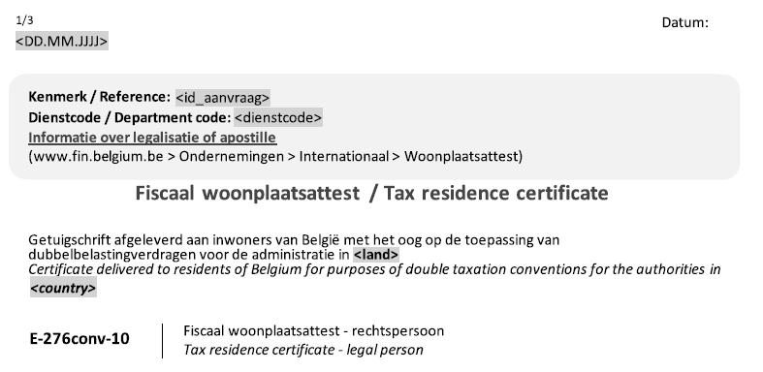
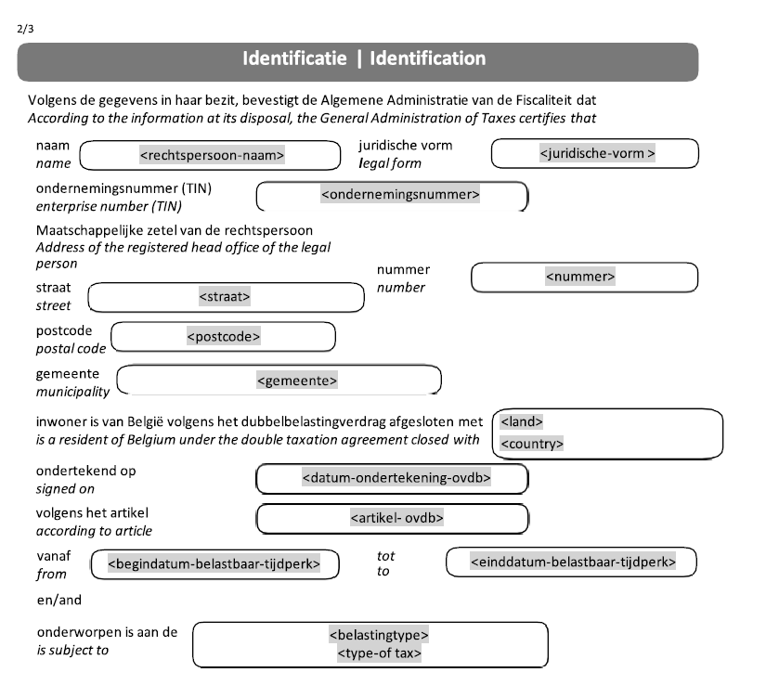
Concept of residency – article 4,§1 OECD Model Convention
Belgian residence certificate if taxpayer invokes DTT
Certificate can be requested online (MyminFin)
Only if a DTT is in force
Certificate is delivered for one country, one taxable period and on type of income only (multiple certificates possible)
In principle available same day

Slide 16
4.
Solving instances of double/multiple residency

Slide 17
Instances of dual or multiple residence
Connecting factors deviate among countries
Formal and factual connecting factors Various factual connecting factors Flexible corporate law (CJEU case law)
WHY?
Different interpretations
Place of (effective) management interpreted differently Various facts valued differently

Slide 18
Solving instances of dual or multiple residence
In most DTTs concluded by Belgium, “place of effective management” (POEM) remains decisive
Belgium did not opt to apply article 4 MLI (MAP)
POEM rarely defined in DTT (exception: DTT concluded with Armenia and the Netherlands not yet in force)
Belgian Courts always interpret POEM in same manner as principal establishment
POEM also relevant for e.g. article 15,§3 OECD MC 2014 – burden of proof more flexible
No transparency regarding decisive facts or number of MAPs in case of interpretation disputes POEM

Slide 19
Solving instances of dual or multiple residence
MAP:
  E.g. DTT concluded with Canada, Japan, US
  Usually no criteria identified that must be considered
  No binding solution
  No timing: exception DTT concluded with Mexico
Hierarchy of test:
  E.g. DTT concluded with China, Korea, Singapore
  POEM mostly first test
  MAP “shall” settle question

Slide 20
Solving instances of dual or multiple residence
Facts
Luxco has statutory seat in Luxembourg.
General shareholders meeting held in Luxembourg.
Luxembourg tax residence certificate.
Luxembourg bank account.
Accounts prepared by Luxembourg accountancy firm.
Belgian resident (X) is sole director of Luxco.
Financial accounts of Luxco found in Belgium.
X has no contractual relationship with Belco but X has an office, parking and telephone available at Belco’s premisses, and factually works for Belco
X regularly (daily) present in Belgium and serves mainly Belgian clients.
Seat of Luxco is situated at address of accountancy firm where 126 other companies are registered.
Correspondence automatically forwarded to X.
GHENT 10 OCTOBER 2023
BELCO
Director
LUXCO

Slide 21
Solving instances of dual or multiple residence
Judgement
Renting an office space at the premises of an accountancy firm (that is not exclusively at the disposal of Luxco) does not demonstrate presence of governing body and management decisions at that place.
Sufficient proof that governing body is regularly present in Belgium.
No proof of activity in Luxebourg or other counterproof.
Luxco is tax resident in Belgium according to article 2 ITC.
Luxco is tax resident of Belgium and Luxembourg according to article 4,§1 DTT.
Luxco has place of effective management in Belgium pursuant to article 4,§3 DTT.
GHENT 10 OCTOBER 2023
BELCO
Director
LUXCO

Slide 22
5.
Assessment and concluding remarks

Slide 23
Assessment and concluding remarks
1
Corporate residence remains key concept in Belgian and international tax law
2
Residence taxation nowadays functions as backstop
3
Globalization complicates determination of tax residence
4
Robust residence remains necessary to achieve underlying purpose
5
Harmonised residence concept to avoid conflicts/abuse

Slide 24
THANKS FOR YOUR ATTENTION
Contact:
Prof. dr. Linda Brosens
Uantwerpen – Loyens&Loeff
Linda.brosens.rw@uantwerpen or Linda.brosens@loyensloeff.com

